Slide 1
Young People Advancing Sexual and Reproductive Health: Toward a New Normal
Youth Investment, Engagement, and Leadership Development (YIELD) Project
Findings Overview
June 2019

Slide 2
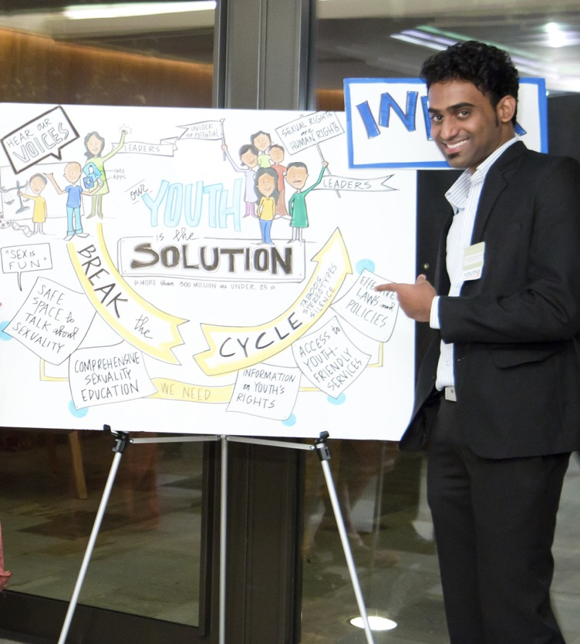
Table of Contents
1. About YIELD
2. Why this report
3. Findings & recommendations
4. Next steps and resources
5. Q&A + discussion
2
yieldproject.org |

Slide 3
The Youth Investment, Engagement, and Leadership Development (YIELD) Project
Steering Committee:
Bill & Melinda Gates Foundation,
David and Lucile Packard Foundation,
The Summit Foundation,
William and Flora Hewlett Foundation
yieldproject.org |
Notes:
Nearly 100 people from over 20 countries shared their experiences, insights, and recommendations to inform continued action in youth investment, engagement, and leadership development for adolescent and youth sexual and reproductive health and rights efforts.
This report synthesizes global evidence from the field on how to foster authentic youth engagement, the impacts that result, and recommendations that can strengthen and scale this stream of programming investment.
The report is a product of the Youth Investment, Engagement, and Leadership Development (YIELD) Project, which is guided by a Steering Committee comprised of the Bill & Melinda Gates Foundation, David and Lucile Packard Foundation, The Summit Foundation, and the William and Flora Hewlett Foundation.

Slide 4
Adolescent and youth SRHR must transform from
a field for young people to one with young people
4
yieldproject.org |
Notes:
Why this report?
Young People Advancing Sexual and Reproductive Health: Toward a New Normal is a research report documenting the multiple benefits of meaningful youth participation and leadership in sexual health and rights (SRHR) programs.
Young people want and deserve the power to make decisions about their bodies, lives, and futures. About their sexual and reproductive health. About whether and when to have sex. About whether and when to have children.
Right now, the largest generation of young people in history is entering their reproductive years. Young people need information about their health and rights, as well as tools and support to make the decisions best for themselves and their circumstances.
Making this happen requires young people’s participation and leadership at every level of adolescent and youth sexual and reproductive health and rights (SRHR) programming—from ideation to implementation.
Adolescent and youth SRHR must transform from a field for young people to one with young people.

Slide 5
Why full youth participation & leadership in SRHR?
Young people:
Are the best experts in their own lives
Are capable and creative contributors
Bring unique and valuable perspectives, resources, and solutions to SRHR efforts
Programs are more efficient and effective when youth fully participate and lead.
yieldproject.org |
Notes:
Not only are young people the best experts in their own lives, they are capable and creative contributors to social change.
They bring unique and valuable perspectives, resources, and solutions to SRHR efforts.
Leveraging this vast potential through a shift to full youth participation is key to accelerating progress toward the outcomes we all want—including the Sustainable Development Goals.
Our findings show that when young people are authentic partners in developing and delivering SRHR solutions, and when adults work alongside youth, programs are more efficient and effective, and young people embark on leadership path that can last a lifetime.

Slide 6
Why this report?
Youth participation and leadership in SRHR is increasing globally
SRHR initiatives involving young people are fragmented, poorly documented
Current field lacks shared vision, coordination
Notes:
SRHR initiatives by and with young people are diverse, exciting, and relatively new—but also fragmented and poorly documented.
The current field lacks the shared vision and coordination needed to move toward a systematic way of working with young people as partners and leaders.
And we can no longer deny that the voices and contributions of young people are essential to the success of SRHR initiatives.
This report synthesizes global evidence from the field on: how to actualize youth participation, what it achieves, and what is needed to do it better.
Whether you are a youth advocate, practitioner, researcher, or funder, and no matter where your organization is in its level of youth engagement, these findings and recommendations offer concrete steps to take youth participation and leadership to the next level.

Slide 7
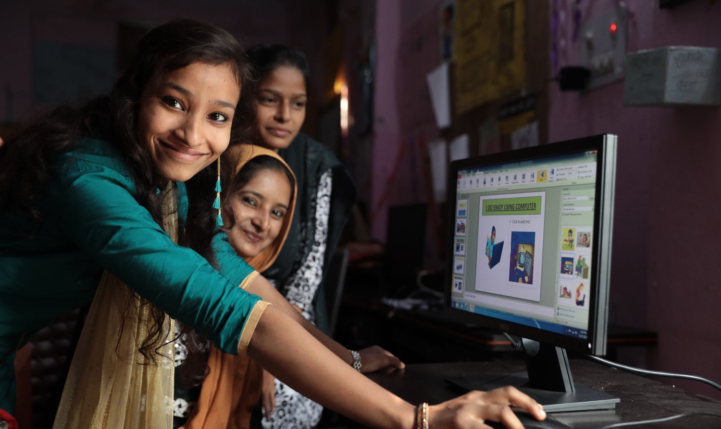
Findings and recommendations
yieldproject.org |
Paula Bronstein/ The Verbatim Agency/Getty Images
Notes:
Paula Bronstein/ The Verbatim Agency/Getty Images

Slide 8
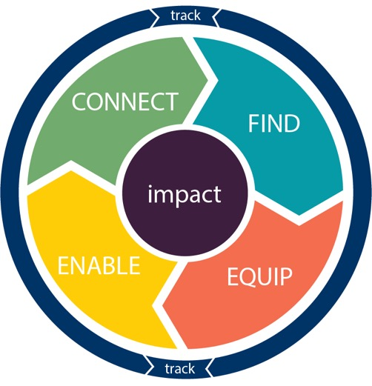
Youth Participation Process Map
FIND: Identify and engage young people in all their diversity
EQUIP: Provide training to build youth knowledge, skills, and capabilities
ENABLE: Foster supportive environments
CONNECT: Create both pipelines and pathways for young participants
TRACK: Develop and implement monitoring and evaluation strategies
policy advocacy | program implementation | service delivery | evaluation | research
yieldproject.org |
Notes:
Given the heterogeneity of young people and varying contexts in which this work happens – the efforts that both serve and engage young people are equally diverse.
As we analyzed the contributions of project stakeholders, we came to appreciate the diversity - and complexity - of work happening under the YIELD umbrella.
The complexity of our data, therefore, mirrors the complexity of diverse interventions.
However, when data were analyzed across contexts, they revealed these high-level domains of activity in youth participation: FIND; EQUIP; ENABLE; CONNECT; TRACK.
The “process map” illustrates both how youth participation is being operationalized and what impacts it is having at different levels.
YIELD cycles are necessarily linear or one-off processes - rather young participants move through these different domains in different AYSRHR experiences
We use the process map as a frame to present YIELD findings

Slide 9
Finding & Engaging Young People: Findings
“To engage a diversity of young people, you need to get out of the capital and out of your comfort zone. The same youth leaders get all the opportunities. We intentionally go out into the middle of nowhere to find more local efforts where important change is and can be made. We fail a lot, but we have to keep trying.”
- female interviewee, global youth-serving organization
yieldproject.org |
Notes:
One thematic element of the youth participation process is identifying and engaging young people, in all their diversity, as participants in youth SRHR efforts across the ecosystem.
From Jamtara, India to Jackson, Mississippi, AYSRHR programs struggle to recruit young leaders outside of an elite few—typically educated, urban, and economically better off.
Across the globe, barriers to youth recruitment and engagement include: geography, age, class, education, ability, ethnicity, caste, sexual orientation, marital status, and parenthood, as well as gender discrimination and gatekeepers.
This leaves behind huge groups of strategically positioned young people ready to be mobilized.
Intentional recruitment of youth leaders from the most underserved communities is urgently needed to expand participation in and benefits of AYSRHR.

Slide 10
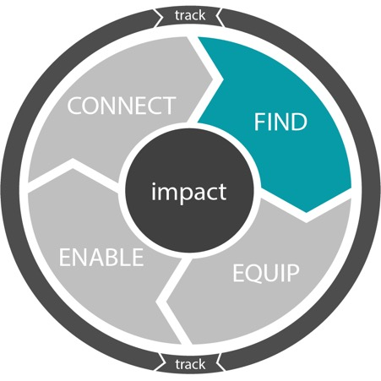
-
Finding & Engaging Young People: Recommendations
Use targeted recruitment strategies
Engage gatekeepers and allies
Begin youth participation at younger ages
Get outside the SRHR sector
yieldproject.org |
Notes:
Recommendations from the field include:
Use targeted recruitment strategies, powered by local knowledge and commitment to engage a diverse cross-section of young people, prioritizing the most underserved.
Engage gatekeepers by making them stakeholders committed to the individual-, family-, and community-level benefits of youth participation.
Begin youth engagement and leadership programming at younger ages, and link programs that engage younger adolescents as pipelines into existing programs.
Expand programming partnerships beyond the AYSRHR sector to activate a broader cross-section of young advocates.
Document results and share details about what is working to engage and sustain diverse youth participation with the broader field.

Slide 11
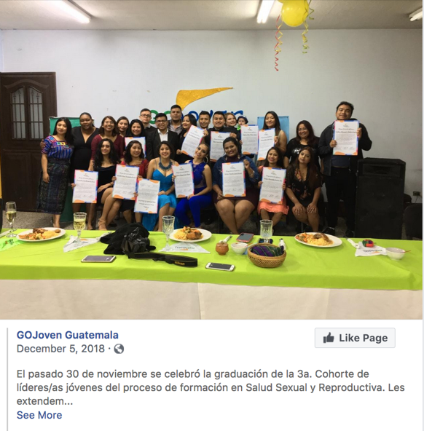
yieldproject.org | 11
Notes:
The GoJoven program, which has evolved into local youth-centered NGOs operating in Belize, Guatemala, Honduras and Mexico, offers an example of broad and diverse youth leader engagement.
GoJoven works through local partners, who are positioned to engage and support a diversity of young people at the grassroots level.
With each program cycle, GoJoven identifies and trains a new cohort of young leaders for SRHR, intentionally targeting those who come from different personal and professional backgrounds.
Program alumni also actively participate in recruiting new cohorts of fellows through their own networks.
Such approaches create inclusive pipelines of new fellows from more isolated and underserved areas.

Slide 12
Equipping & Training Young People: Findings
“Through human rights-based sensitization, I started to see the relevance of national policies in my own life. It became clear to me that – in order for us to access the information, services, and support, we need to make our own decisions and control our bodies – we need to be actively involved.”
- young female interviewee, Nigeria
yieldproject.org |
Notes:
Another thematic element of the youth participation process is equipping and training young people in order to build their knowledge, skills, and capabilities.
For young AYSRHR program partners to learn, share, and grow, training environments must be supportive.
They must foster mutual respect, inclusivity, tolerance, and collaboration.
They must be safe physical and emotional spaces—especially for marginalized youth.
And adequately equipping young people to participate and lead is about much more than SRHR.
The best training covers not only SRHR, but also builds self-confidence, clarifies personal values, develops empathy, and fosters critical thinking.
In addition, youth participants express interest and need for management, networking, and advocacy skills to catalyze their AYSRHR contributions and propel them into lifelong civic engagement.

Slide 13
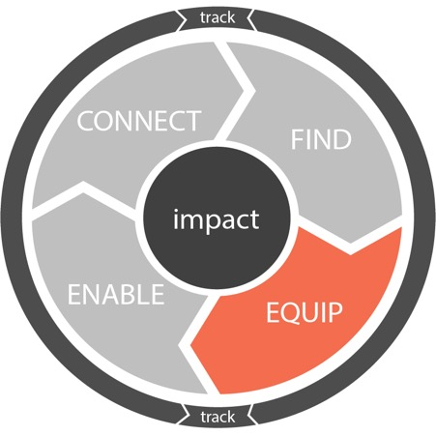
Equipping & Training Young People: Recommendations
Foster safe, supportive training environments
Localize training opportunities
Let young people collaborate on content and design
Use participatory methods
13
yieldproject.org |
Notes:
Recommendations from the field include:
Foster safe, supportive, culturally appropriate training environments.
Reach more and diverse groups of young people by offering training at local levels, in local languages, while also facilitating access to instruction in globally dominant languages when requested.
Provide flexible content that allows young people’s experiences, interests, and SRHR needs to inform delivery, while also giving them opportunities to collaborate on content development.
Use participatory trainings to deliver ongoing, layered content in ways that build the social, technical, and financial skills of young people—and enable them to teach what they know to others.
Leverage platforms to share and exchange existing training tools and approaches that have demonstrated effectiveness.

Slide 14
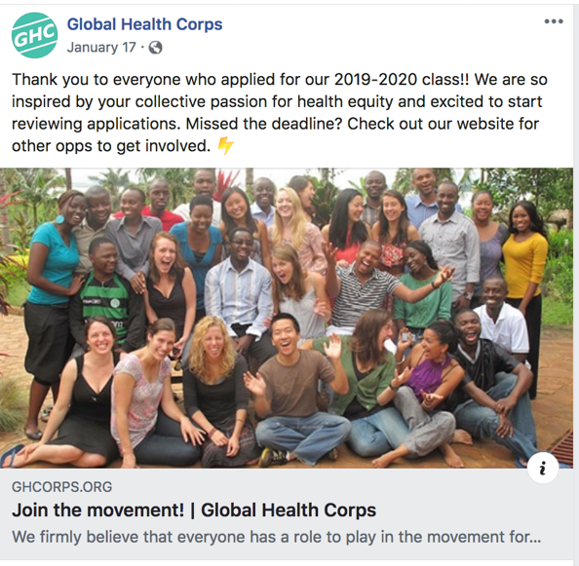
yieldproject.org | 14
Notes:
Global Health Corps uses its Training Institute to prepare each new cohort of diverse change-makers to maximize their impact over the course of their year-long fellowships and beyond.
The Training Institute also helps shape the communities that will sustain these emerging leaders in their long-term commitment to service.
An important part of the training focus is on supporting fellows in their deepening personal commitment to leadership.
This is done through peer-based reflection and dialogue groups, as well as through explorations of the spiritual and emotional dimensions of leadership.
As part of this, fellows explore topics such as personal values, resilience, courage, and ethical decision-making.
While this process can be difficult for participants, many view these shared inner journeys as critical for developing trust in themselves, each other, and the program.
One respondent described these bonds as the “secret sauce” of leadership development.

Slide 15
Enabling Young People: Findings
“The current paradigm places an unfair burden on young people to change the systems and structures that impede their contributions. They cannot do this alone. In order to contribute, young people need supportive adults and enabling environments that permit them to exercise their individual and collective agency.”
- female interviewee, youth-serving organization, U.S.
yieldproject.org |
Notes:
Another thematic element of the youth participation process is fostering supportive environments that allow young people to exercise their agency and become genuine contributors to AYSRHR efforts—because even the most holistic individual training only goes so far.
Young people and the adults working with them must also contend with the policies and practices, norms and beliefs, and structures and systems that shape—and limit—youth participation and leadership in AYSRHR.
Many youth interviewees reported experiencing ageism, stigma, and tokenism when working intergenerationally.
They also reported not being fairly compensated for their contributions, and not feeling sufficiently supported on the job, which leads to burnout.

Slide 16
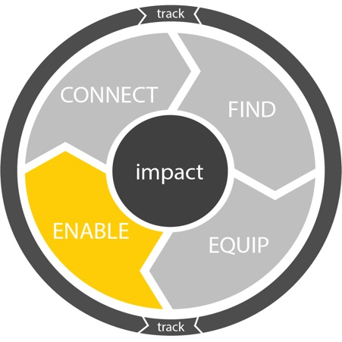
Enabling Young People: Recommendations
Operationalize youth participation and leadership at all levels:
Train staff to share power with youth
Establish quotas for youth representation in governance
Let youth participate across programs and divisions
Absorb program graduates as staff
Ensure mentorship for young leaders
Compensate young people fairly
yieldproject.org |
Notes:
Recommendations from the field include:
Operationalize youth participation and leadership across stakeholder institutions and sectors committed to improving AYSRHR. This could take the form of:
Training staff, volunteers, and service providers at all levels how to share power in youth-adult relationships
Quotas for youth representation at all levels of governance, and integration of young people across programs and divisions
Youth participation in full program cycles
Intentional efforts to absorb program graduates as new staff
Ensure that youth participants and leaders have ongoing access to mentors and professional accompaniment.
Compensate young people fairly, with a stipend or salary, for their time and unique contributions.
Provide ongoing monitoring and support to ensure that genuine youth participation is taking place.

Slide 17
Enabling Young People: Funder Recommendations
Stakeholders want to see:
Longer program cycles and/or general operating support
Greater flexibility
Technical assistance
Dedicated funding for M&E, documentation, and dissemination
yieldproject.org |
Notes:
Stakeholders cited funder behavior as undermining the ability to do youth leadership development well: grants are too short, technical assistance too limited, monitoring and evaluation too onerous.
Recommendations from the field include:
Fund youth-led and youth-run efforts in ways that maximize their effectiveness. This could look like:
Longer program cycles and/or general operating support
Openness to flexibility
Technical assistance
Dedicated funding for monitoring and evaluation, documentation, and dissemination

Slide 18
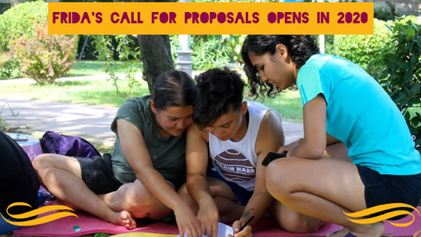
yieldproject.org | 18
Notes:
Several stakeholders--both youth and adult--mentioned FRIDA: The Young Feminist Fund’s particularly powerful approach to mentoring.
FRIDA mobilizes slightly-older, local, female advisors to work with young female grantees.
These advisors share cultural and linguistic backgrounds with their grantees – and often have the additional advantage of intimate familiarity with the local contexts in which grantees operate.
The dynamic in these relationships is one of open, horizontal collaboration, which forms the basis for trust, honesty, and mutual confidence.
Not only do mentoring relationships of this kind enrich the quality of current youth-driven and youth-led AYSRHR efforts, but these relationships also tend to have ripple effects into the future.
Both mentees and mentors spoke about two-way benefits that extend beyond the formal terms of a project or initiative.
These benefits can include access to broader and more diverse networks, expanded resource pools, new professional opportunities, and joint collaborations.

Slide 19
Connecting Young People to What’s Next: Findings
“Many of us face big challenges in transitioning from the range of opportunities available to ‘young people’ to relatively fewer after the age of 30. More options should be available to help bridge this period as we move into professional roles at higher levels.”
- young male interviewee, Sri Lanka
yieldproject.org |
Notes:
Another thematic element of the youth participation process is creating pipelines and pathways for young participants to enter the YIELD cycle, and engage in repeated cycles, in order to age “up” rather than age “out” of the field.
Young people shared two main frustrations about youth roles in AYSRHR:
1) as youth, the difficulty in advancing to new opportunities and making professional transitions, and
2) once they “age out” of youth roles, the evaporation of support.
These create field-wide challenges to retaining young talent and supporting the professional development of young people.

Slide 20
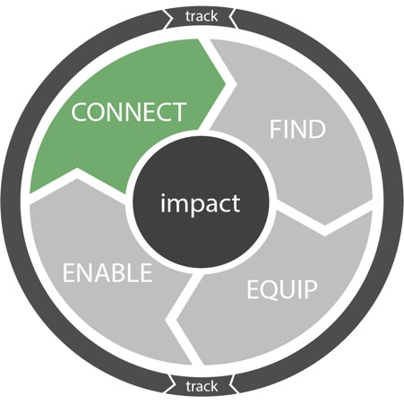
CONNECT
Connecting Young People to What’s Next: Recommendations
Support formal peer and professional networks
Create pathways for young people to “age up” rather than age out
More entry-level positions
Transitions to higher-level, paid roles
Two-way, local-to-global youth-participation feedback loops
Connect and support cohorts of young leaders—across sectors
yieldproject.org |
Notes:
Recommendations from the field include:
Establish formal peer and professional networks to support youth participants both during and after their program experiences. These help young people stay on a learning and leadership path in SRHR and beyond.
Create pathways within and across initiatives for young people to build their knowledge, skills, and experience—and move into roles of increasing responsibility and influence. This can look like:
Creating more entry-level positions in both established and developing organizations
Supporting young people in their transition to higher-level, paid roles
Strengthening two-way, local-to-global youth-participation feedback loops
Connect and support cohorts of young leaders—across sectors—to foster solidarity, feedback loops, and collective action at the local, sub-national, national, and international levels.

Slide 21
CONNECT
yieldproject.org | 21
Notes:
The Planned Parenthood Federation of America has created a unique and effective intra-institutional strategy to recruit, train, and retain activists and organizers from adolescence into adulthood.
Through its national network of clinics, Planned Parenthood identifies young people between the ages of 15-18 and trains them to be AYSRHR peer educators with a basic foundation in SRHR advocacy.
These young people can then move on to become members of the Planned Parenthood Generation Action Network, which is geared towards young people between the ages of 18-22.
Each youth advocate gets training in undertaking SRHR-related campaigns and awareness-raising activities on college campuses and in communities across the country.
From the age of 22+, these now-experienced influencers can participate in the Planned Parenthood Defenders Program and serve on Community Action Councils, this time as adult professionals.
Each of these programs serves as a feeder to the next one, thereby creating linked pipelines and pathways for local and national engagement on SRHR issues.

Slide 22
Tracking the Results of Youth Participation: Findings
“I am sure things would be far worse without our work. We have so many stories to tell and so many demonstrations of positive impact on individual lives. We need better ways to communicate our stories of success and aggregate them to show the value of our work.”
- female former youth leader, with youth-serving organization, U.S.
yieldproject.org |
Notes:
Another thematic element of the youth participation process is to develop and implement monitoring and evaluation strategies that document the results of youth participation at different levels.
This is crucial because SRHR practitioners are seeing the impacts of youth contributions on the ground, but monitoring and evaluation in the field only tracks a small fraction of these impacts.
And this lack of evidence is holding the field back—it is one of the biggest roadblocks to further investment.
Barriers to robust M&E include: few dedicated resources, the fragmented nature of the field, and a lack of consistent indicators.
Additionally, the handful of organizations that have M&E capacity are too disconnected to share best practices, forcing each institution to reinvent the wheel.

Slide 23
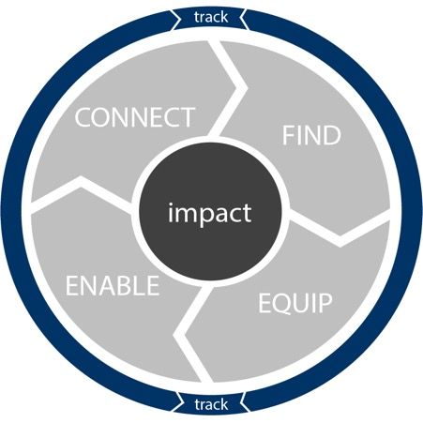
Tracking the Results: Recommendations
Budget for and build M&E into program design
Create cross-stakeholder communities of practice to share learnings
Identify research opportunities in current programs
Enable two-way research-practice partnerships
Engage young people in evidence generation
TRACK
yieldproject.org |
Notes:
Recommendations from the field include:
Build sufficient resources for effective monitoring and evaluation into project proposals, and integrate evaluation strategies into programming from its inception.
Create cross-stakeholder communities of practice to share current learning and coordinate action around common YIELD for AYSRHR purposes, methodologies, and indicators.
Identify potential research opportunities across current program portfolios, in order to nest common experiments and address ongoing knowledge gaps.
Leverage social-science research expertise from SRHR and beyond to enable genuine, two-way research-practice partnerships. Such collaborations build the internal research capacity of implementing organizations, while also generating more and better external evaluations.
Engage the unique contributions of young people in evidence generation, while always ensuring appropriate training, support, and safeguarding.

Slide 24
Impact of Youth SRHR Participation & Leadership
When young people’s participation is supported, it creates virtuous cycles that contribute to positive change across the youth SRHR ecosystem.
This research explored the impact of youth participation and leadership in SRHR initiatives on:
Young people
SRHR ecosystem
Broader civil society
IMPACT
yieldproject.org |
Notes:
Though this relatively new field struggles to generate rigorous evidence of impact, practitioners on the ground consistently emphasized impact at three levels: in young people, the SRHR ecosystem, and broader civil society.

Slide 25
Impact on Young People
“My experience working (as a youth representative on a global research initiative) took me out of my comfort zone. It was hard, but it really motivated me to learn about new things, and made me more confident and articulate. And it was great for my networking skills. I am now connected to the top players on the global development stage, and I continue to connect with them both professionally and personally.”
- young male informant, Sri Lanka
yieldproject.org |
yieldproject.org |
Notes:
In terms of the impact on young people:
As a result of their contributions to AYSRHR efforts, young people experience both personal and professional growth, gaining both life skills and leadership skills.
And building things like self-confidence, purpose, agency, and resilience are demonstrated protective factors in reducing negative health outcomes among adolescents.
Comprehensive AYSRHR initiatives that build young people’s knowledge, skills, and capabilities prepare them to be good citizens and good parents later in life.
However, the benefits of youth participation and leadership – at levels beyond the most local – currently accrue to a limited group of relatively elite young people. Which goes back to the importance of intentional recruitment.

Slide 26
Impact on the SRHR Ecosystem
“Anyone who wants proof of the impact of youth advocates need look no further than recent movements in the United States: Black Lives Matter, United We Dream, and the Women’s March together have changed the fabric of our country. These issue-inclusive mobilization groundswells were all run by women of color under the age of 30.”
- female interviewee, youth-serving organization, U.S.
yieldproject.org |
yieldproject.org |
Notes:
We were able to isolate at least two distinct categories of impact in the SRHR ecosystem.
Youth participation strengthens organizations. Involving young people in youth SRHR efforts helps organizations become more connected, responsive, and innovative in their efforts. This, in turn, helps clarify organizational missions and improve organizational programming.
Youth participation contributes to outcome-level AYSRHR impacts. The outcome-level impacts that youth participation has on the ecosystem of youth SRHR efforts are among the most difficult to disentangle.
A significant part of the impact that youth participation has on the youth SRHR ecosystem is in the form of new youth-led projects, campaigns, and organizations. Our interviewees spoke repeatedly about the impacts that these kinds of youth-led efforts have on the field of youth SRHR – including, but not limited to, areas of programming, service delivery, advocacy, and research.
Youth participation in SRHR is also good for adults. When adults interact closely with young people, they come into direct contact with the energy, passion, and creativity of youth. They experience first-hand the unique contributions that young people make, and the unique knowledge and skills that they possess. All of this helps adults to see youth leaders as legitimate partners in SRHR efforts. As a result, adults begin to make more space for young people’s participation and leadership.

Slide 27
Impact on Civil Society
“Having [young people] on staff has allowed us to institutionalize youth insights in all of our work. This unique perspective was missing before. They are basically our quality control unit. Based on their constant input, we have changed our messaging, service-delivery strategies, and feedback mechanisms. And, as a result, we see increasing numbers of young service users. Young people are such a valuable resource for us. We should have done this a long time ago!”
- female interviewee, global youth-serving organization, U.S.
yieldproject.org |
Notes:
If the outcome-level impacts that youth engagement has on the AYSRHR ecosystem are difficult to quantify, more difficult still are the impacts that youth participation and leadership have on civil society.
However, our findings suggest that not only are these impacts occurring, but they are occurring in powerful and meaningful ways.
Sustained civic engagement around AYSRHR and related issues – by and with young people – helps shift both social norms and public policy.
As young people become increasingly involved with SRHR efforts, they become more aware of their rights and more civically engaged.
They take their first steps along a path that leads them to become lifelong advocates on SRHR issues.
They become champions for change, a role they often continue and grow throughout adulthood.
Today’s youth SRHR participants are tomorrow’s civil society leaders.

Slide 28
A call to action for SRHR stakeholders
Work with youth as partners
Collaborate with others who are advancing youth participation and leadership in SRHR
Establish a shared vision for the field
yieldproject.org | 28
Notes:
It’s time to mainstream meaningful youth participation and leadership development.
Young people can and should play a part in all aspects of SRHR efforts that impact them, not only because it benefits them, but also because it improves the quality and responsiveness of health programs.
We call on stakeholders in the AYSRHR space to:
1. Work with youth as partners. Leverage their ideas and experiences, and work alongside them to achieve their goals for SRHR and beyond.
2. Collaborate with others advancing youth participation and leadership in SRHR. Coordinate to reduce field-wide fragmentation and share learnings.
3. Establish a shared vision. Work with young people to create a shared agenda for the field. Build in measurable milestones and accountability mechanisms, and fully resource implementation.
More and better investment in youth participation and leadership is essential for SRHR programs—and the young people in them—to realize their full potential.

Slide 29
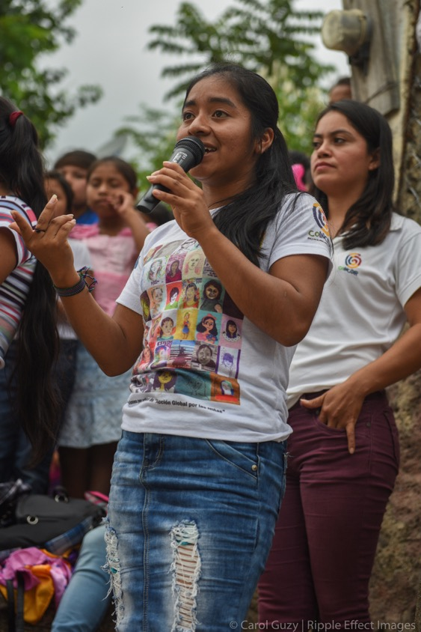
What can you do to help create a
new normal in
youth SRHR?
yieldproject.org |
Notes:
What can you do NOW to work toward “a new normal”:

Slide 30
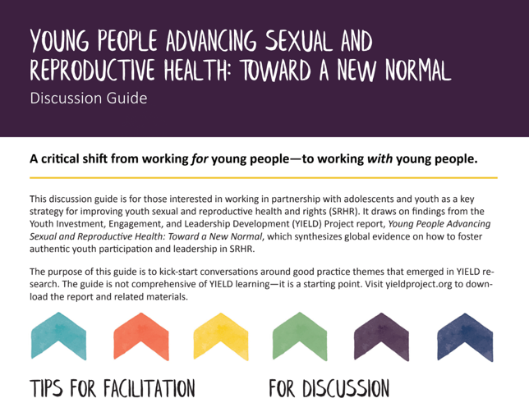
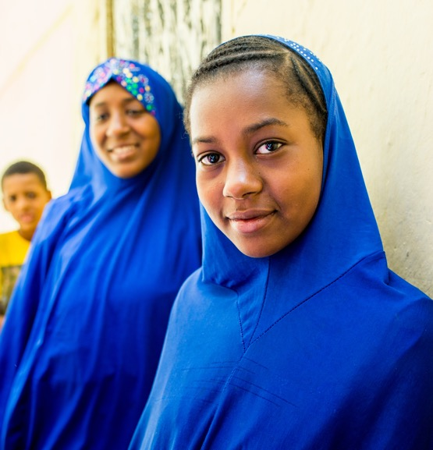
Have 1 conversation within the next 30 days
yieldproject.org
©Gates Archive/Dominique Catton
yieldproject.org |
Notes:
Take a pledge
We invite you to take a simple pledge: Have 1 conversation at your organization within 30 days about how you can take youth participation and leadership to the next level. Wherever your organization is in engaging youth, how can you do a little bit more? We have developed a discussion guide to help orient and support your conversations. The discussion can be downloaded at yieldproject.org.

Slide 31
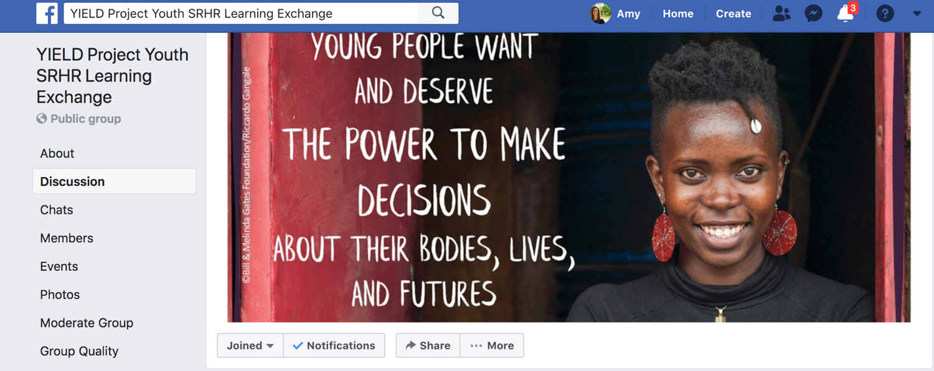
Join the YIELD Project Youth SRHR Learning Exchange
yieldproject.org |
Notes:
Join the Learning exchange
Take the pledge by joining the public Facebook Group: YIELD Project Youth SRHR Learning Exchange.
This group is one step toward creating a cross-stakeholder community of practice to share learning. Such a space is something we heard people wanted.
We invite you to also use the Facebook Group to share how your organizational discussion went, and any learning you may have so far around the five domains of the youth participation process: find, equip, enable, connect, and track. What’s working? What’s not? What tools or practices can you share?

Slide 32
Next Steps and Resources
Take the pledge to have 1 conversation at your organization within 30 days
Join the FB group: YIELD Project Youth SRHR Learning Exchange
Visit yieldproject.org
Discussion guide
Storytelling dice
Social media toolkit
Connect with us at info@yieldproject.org
yieldproject.org |
Notes:
In summary, we invite you to take a simple pledge: Have 1 conversation at your organization within 30 days about how you can take youth participation and leadership to the next level. Wherever your organization is in engaging youth, how can you do a little bit more?
Take the pledge by joining the public Facebook Group: YIELD Project Youth SRHR Learning Exchange.
This group is one step toward creating a cross-stakeholder community of practice to share learnings. Such a space is something we heard people were hungry for.
We invite you to also use the Facebook Group to share how your organizational discussion went, and any learnings you may have so far around the five steps of the youth participation process: find, equip, enable, connect, and track. What’s working? What’s not? What tools or practices can you share?
Download a discussion guide and the storytelling dice for your organization’s youth engagement conversation at yieldproject.org. Other resources at that site include the full report, executive summary, a social media toolkit.
You can also feel free to contact the YIELD project team at info@yieldproject.org

Slide 33
Q&A + Discussion
©Bill & Melinda Gates Foundation/Ryan Lobo
yieldproject.org |
Notes:
This is an opportunity field questions from participants.
(If necessary, can seed with questions from the discussion guide:)
Find
What barriers do you currently experience in terms of recruiting and retaining a diversity of young people as participants and leaders in our programming?
How are you engaging parents, siblings, spouses, additional family members, and other gatekeepers to support youth participation and leadership in our programming and in their communities?
How are you working with actors/partners beyond the SRHR sector to activate a broad range of youth leaders to address SRHR issues?
Equip
How are young people engaged in the design, implementation, and evaluation of our training efforts? How do you keep training content fresh, flexible, and responsive to young people’s needs and interests?
How do your training efforts help build the personal, technical, and functional capabilities of young people over time?
How do you share and access training content and methodologies that have been proven to be effective?
Enable
How is youth participation and leadership reflected in you institutional vision and strategy?
What words describe your organizational culture around power sharing with young people? How are staff trained and supported to work in genuine youth-adult partnership?
How do you foster ongoing mentoring and support of young people in our organization and programming?
How do you acknowledge and compensate young people for their time and contributions to our work?
Connect
How do you help young people establish relationships with and stay connected to peer and professional networks during and after their programming experience or engagement with our organization?
How are you able to support interested young people to create pathways among SRHR training and leadership experiences?
What are/can you do to connect cohorts of young people to foster local, sub-national, national, and international solidarity and collective action?
Track
How do you see the benefits of participating in youth SRHR communities of practice that could allow stakeholders to agree upon and work toward common purposes and measure impact in a more coordinated manner? If such platforms do not currently exist, what would it take to build such an entity in our context?
How might you benefit from access to external evaluation and research support to build institutional capacity and generate more robust results? If such access does not exist, how could it be established?
How are you currently engaging young people in our monitoring and evaluation efforts?

